Slide 1

From Anomaly detection to botnet classification: a comprehensive ML pipeline for iot security
By: joseph Lee 7/24/25
Dataset: detection of iot botnet attacks n baiot
Source: https://archive.ics.uci.edu/dataset/442/detection+of+iot+botnet+attacks+n+baiot

Slide 2
Botnets sound cute… what’s the big deal??
What ARE botnets?
Botnets are networks of internet-connected devices (like computers, phones, IoT gadgets) that have been infected with malware and are being controlled remotely by an attacker, often without the owner's knowledge.
They are used for:
DDoS attacks - they flood a website until it crashes
spam campaigns - send millions of phishing emails
data theft/keylogging - steal login credentials
crypto mining - use your device to mine crypto
click fraud - fake ad clicks for revenue
spreading malware - infect other systems

Slide 3
How they work
Malware infects a device (eg. via phishing, weak passowrds, open ports)
The device becomes a "zombie" - quietly waits for commands
All zombie devices are controlled by a command and control (C&C) server
Attacker sends order to launch attacks or harvest data
IoT botnets increasingly target smart devices such as doorbells, cameras, thermostats, and baby monitors, because they often have poor security, making them easy targets

Slide 4
What can be done?
Network-based intrusion detection systems must be built to:
Monitor traffic from IoT devices, consisting of benign and attack types
Detect abnormal patterns in network traffic associated with botnet activity
Identify the specific botnet family and attack type based on detected patterns
Report the family and attack type for the system to properly respond and defend itself

Slide 5
Business value of predicting attack types
Network security can be improved, providing early and accurate detection of botnet traffic before devices are compromised
Models can predict what kind of attack is occurring for faster incident response, so that security can act quickly and confidently
Accurate models will lower operational costs, minimizing false alerts and reducing alert fatigue and unnecessary investigations.

Slide 6
Part 1 – training a binary classifier to detect whether a network event is benign or an attack
Data from 9 IoT devices was collected and loaded
Network traffic types included benign and multiple botnet attack types
Data was split into benign and attack (general) types
Plots were used to visualize benign vs attack and determine what features did not provide much class separation power
Features with visually distinct distributions were kept for use in training
Unsupervised isolation forest model was trained first to establish a baseline to mimic real world situations where new attacks may not yet be labeled
Iso forest model had a high false positive rate and many false alarms

Slide 7
Part 1 - training a binary classifier to detect whether a network event is benign or an attack
3 additional models used/trained: logistic regression, random forest, and XGBoost
Random search and grid search cross validation used to find best parameters for all 3 models
All 3 models had excellent performance, a drastic improvement over unsupervised isolation forest. They rarely misclassified benign traffic and almost always detect attacks
XGBoost was the best choice overall

Slide 8
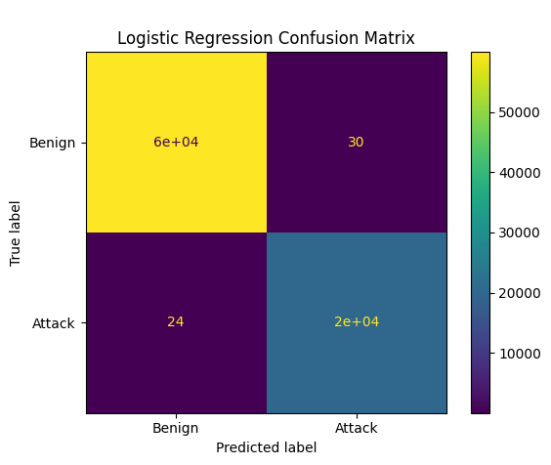


Model confusion matrices
All 3 models performed extraordinarily well, with very few misclassifications

Slide 9
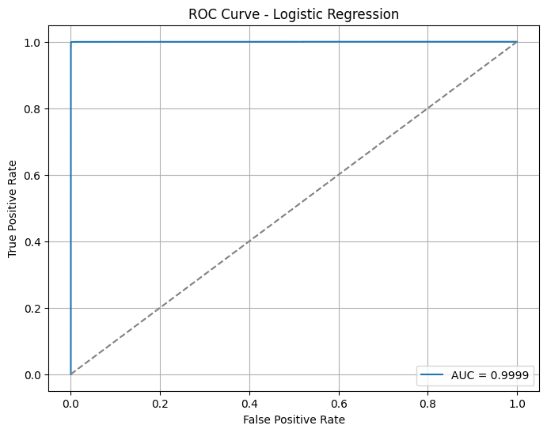
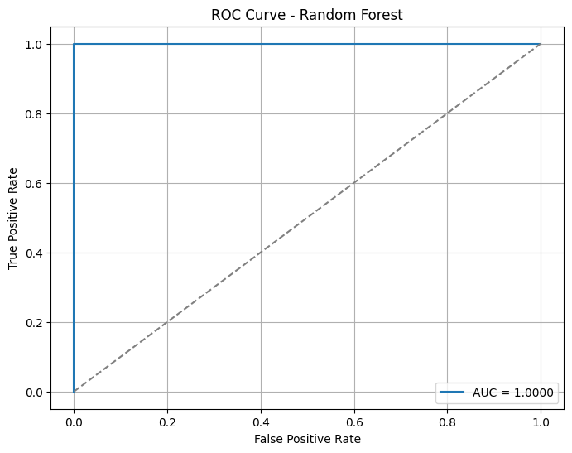
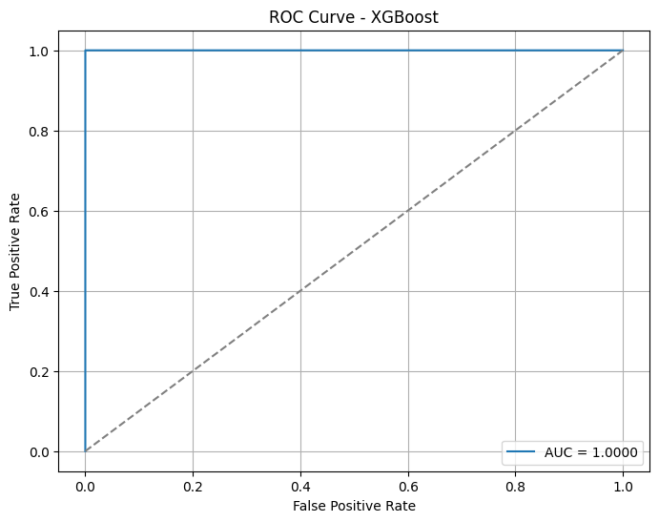
ROC Curves
All 3 ROC indicate the models are highly capable of distinguishing between benign and attack traffic.

Slide 10
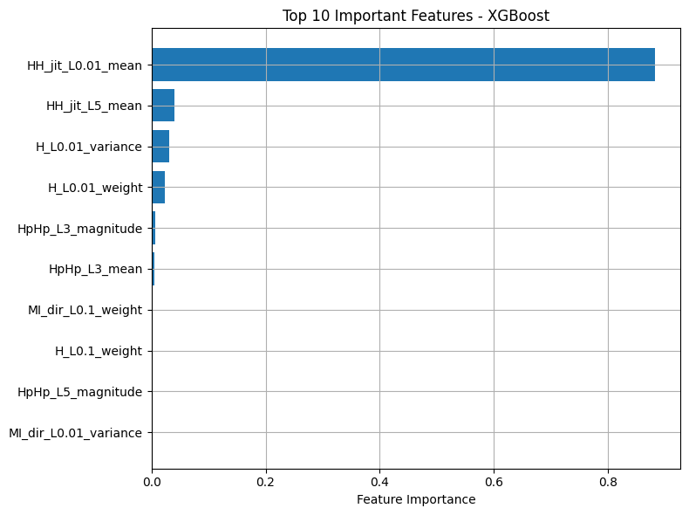
Most important features for predicting attacks
HH_jit_L0.01_mean is by far the feature with the greatest impact on predicting whether an event is an attack or benign in the XGBoost model.
HH_jit is the feature for stats summarizing the jitter of the traffic going from this packet's host (IP) to the packet's destination host. Jitter is a measure of variability or inconsistency in the timing of data packets as they travel across a network. This information is useful for botnet detection because botnets often generate rapid, bursty, irregular traffic. Their traffic is not smooth or predictable and is randomized to avoid detection. It Botnet traffic is more chaotic than benign activity basically. HH_jit is so predictive because botnets cause high-frequency, high-variability traffic bursts, while normal IoT devices behave calmly and predictably.

Slide 11
Part 2 – training a multi-class model to identify specific botnet families
Part 2 used the same dataset but broke the data into 11 classes: benign, and 10 botnet family/attack types
Data was visualized, and showed how different attacks exhibited different behavior in all the different features capturing network activity and associated statistics
Only Random forest and XGBoost were used for part 2 as they outperformed logistic regression in part 1

Slide 12
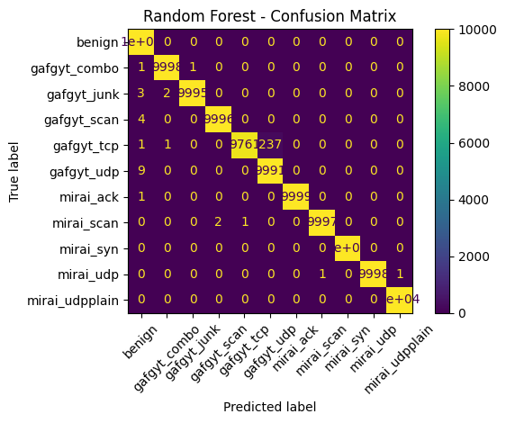
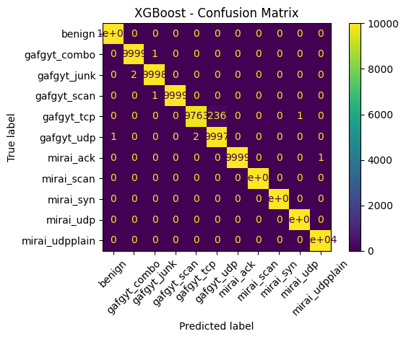
Random forest and XGBoost confusion matrices
Most classes have correctly classified samples out of 10,000. There are only minor off-diagonal values with 1-3 samples misclassified. The only noticeable confusion is between gafgyt_tcp and gafgyt_udp

Slide 13
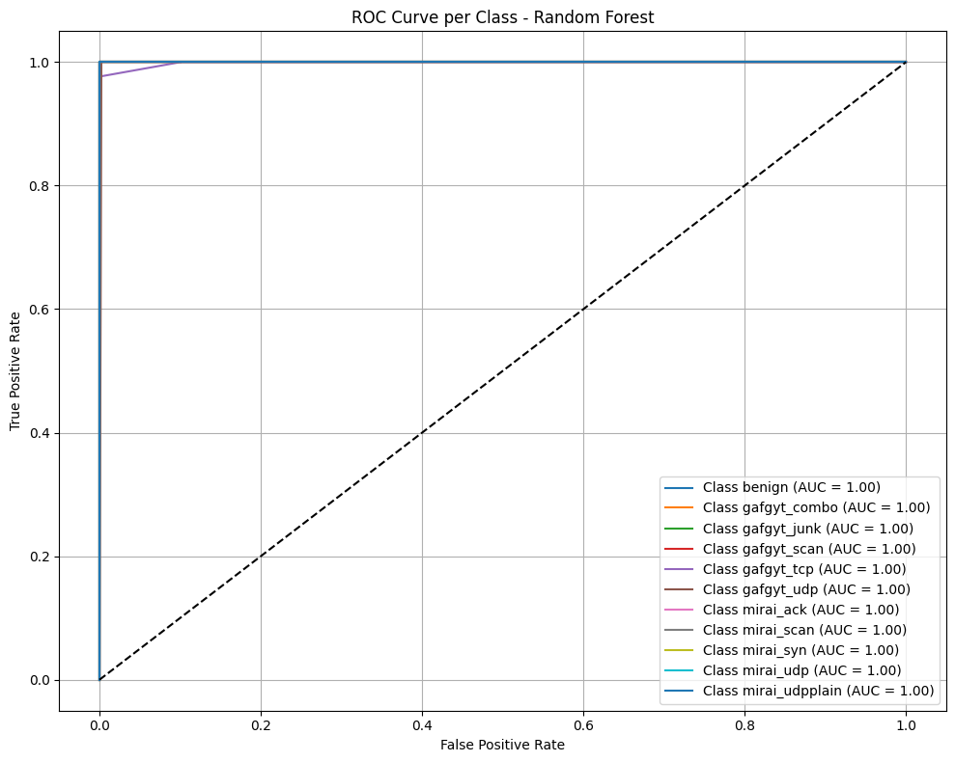
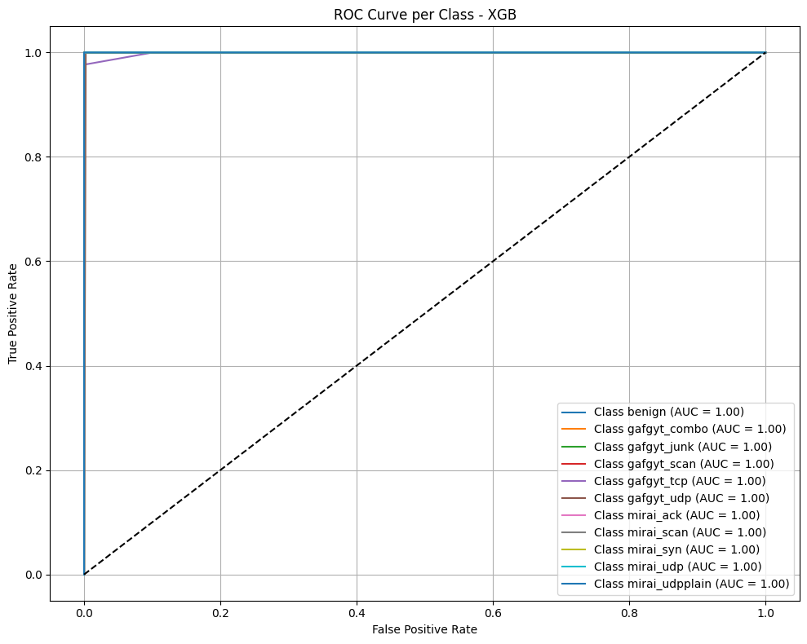
ROC Curves
There is perfect class separation for each botnet type. The curves indicate the classifier has near-zero false positives and maximum true positives

Slide 14
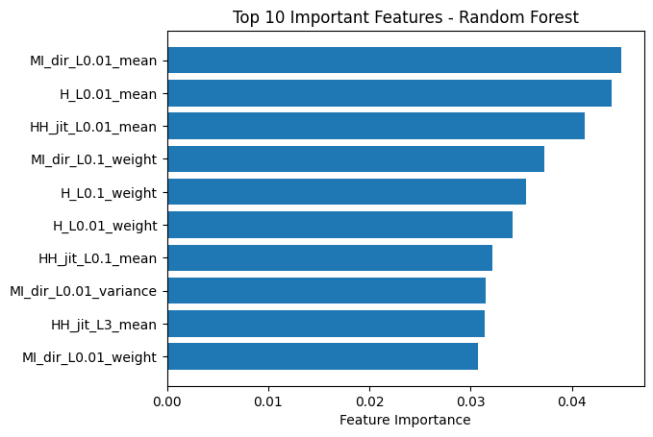
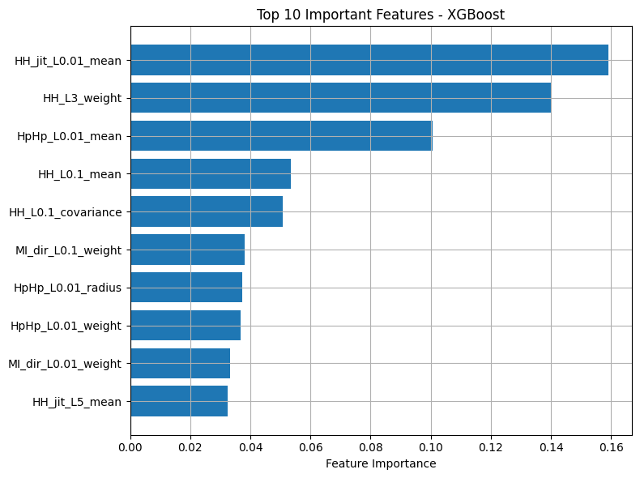
Most important features
Mutual Information (MI) and Entropy (H) dominate as the most important features. They are essential for traffic pattern analysis in botnet detection.
Features for early lag windows (L0.01, L0.1) are most influential as botnet behavior likely leaves strong signatures early in flows.
The XGBoost model shows a different perspective than Random Forest. It emphasizes different dynamics in the traffic data. It emphasizes jitter and hop-level entropy more than Random Forest. it focuses on fine-trained network signal variance, indicating sensitivity to subtle traffic behavior shifts.

Slide 15
recommendations
The XGboost model should be deployed and used to flag and block suspicious traffic in real time.
Priority should be given to monitoring features like jitter and hop-level entropy describing traffic data dynamics.
The model should continue to be trained periodically with new traffic data to ensure detection of evolving traffic patterns.

